Slide 1





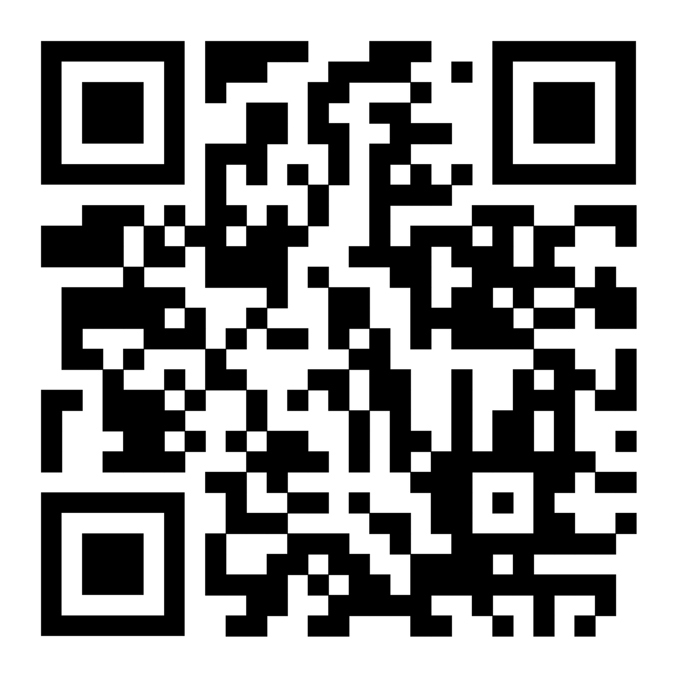
WE WOULD LIKE TO HEAR ABOUT YOUR ONLINE EXPERIENCES
Our research aims to explore the presence and nature of negative or harmful experiences online, and how this may (or may not) affect people’s mental health and wellbeing.
We would still like to hear from you even if you have not had any negative or harmful experiences online!
Are you aged 16-40 years and live in the UK?
Please take part in our ANONYMOUS ONLINE SURVEY (approx. 20 minutes) by scanning the QR code or visiting: https://uofg.qualtrics.com/jfe/form/SV_9KqFjIOjJj9F9QO
For any questions, please email us at: safer-tech-project@glasgow.ac.uk
For more information, please visit our website: https://www.gla.ac.uk/schools/healthwellbeing/research/mentalhealth/projects/safer-tech/

